Slide 1

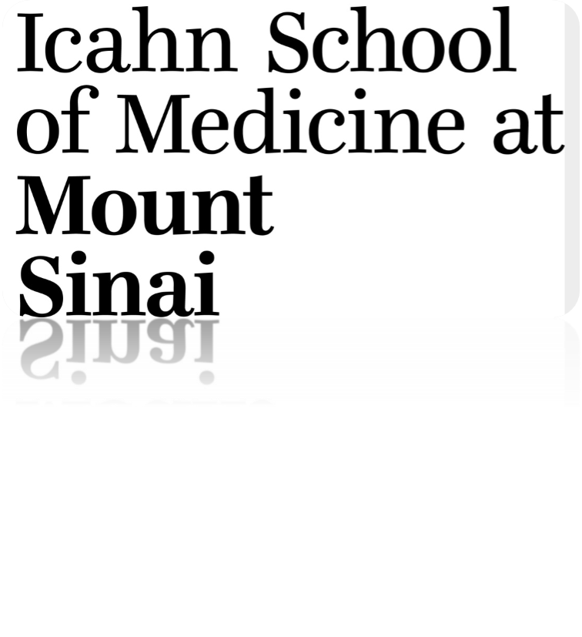
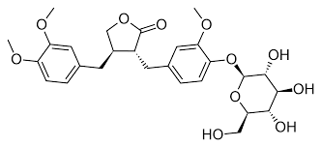
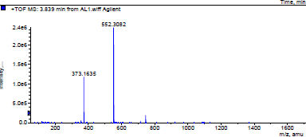
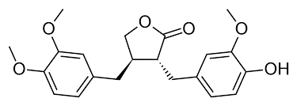
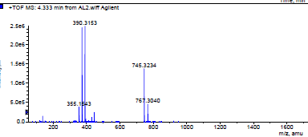
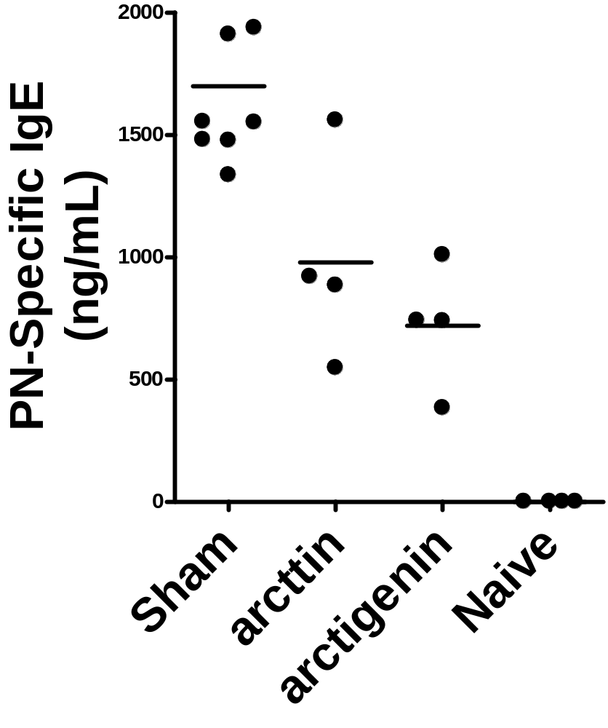
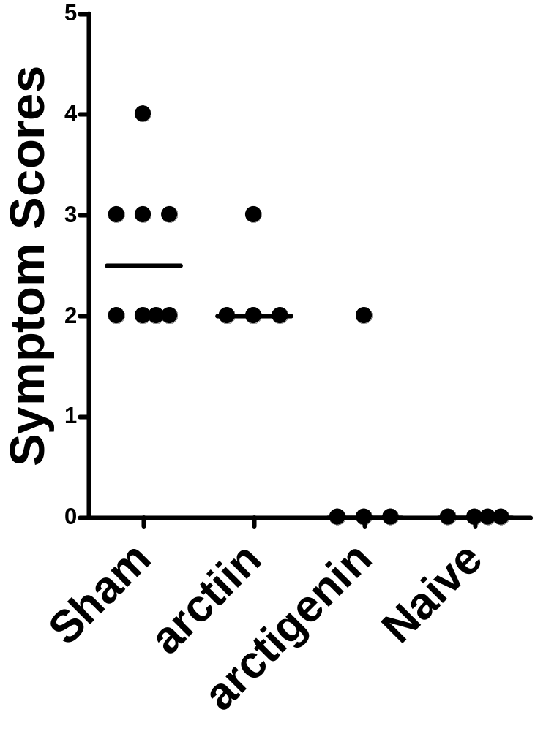
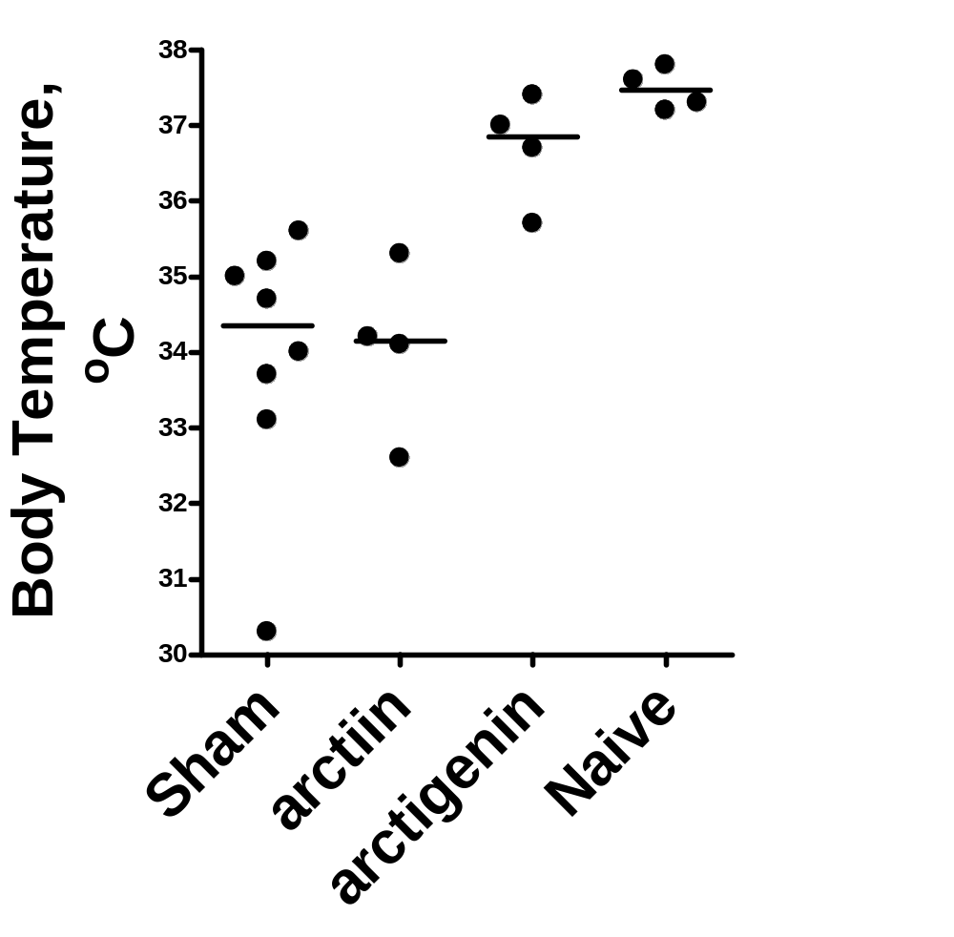
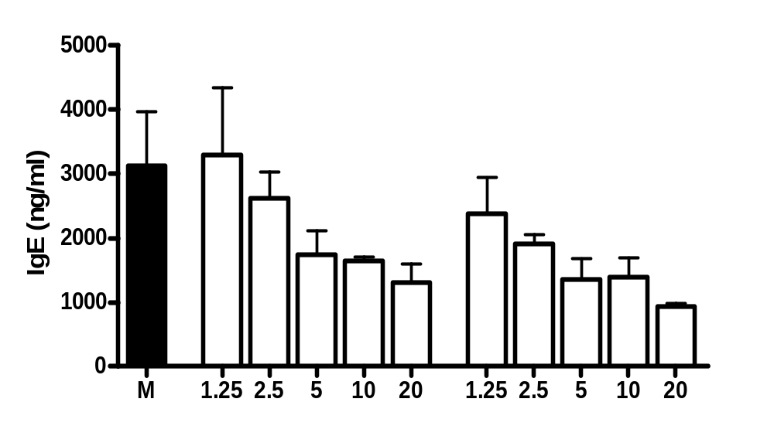
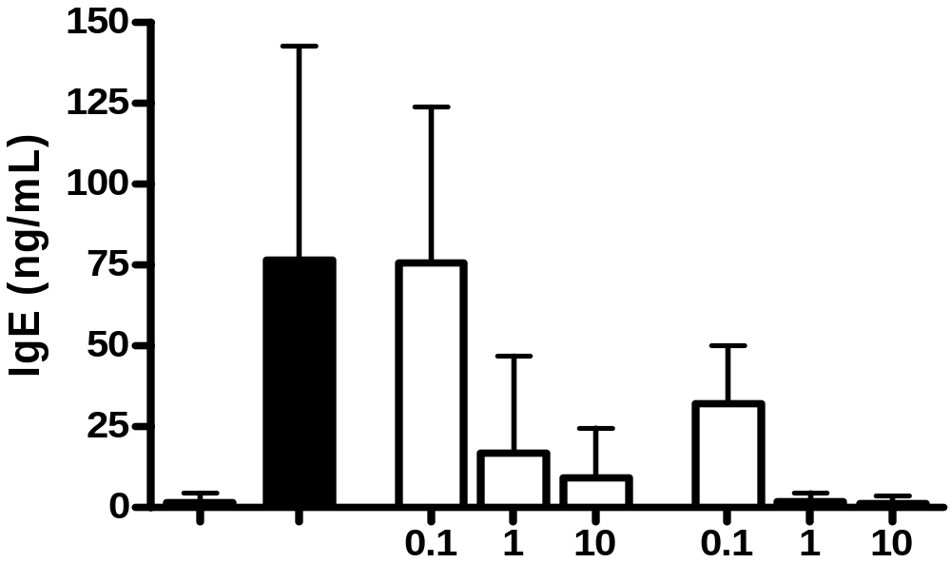
Arctigenin Isolated From Arctium lappa L. Inhibits IgE Production
Changda Liu, Kamal D. Srivastava, Nan Yang, Madisyn A. Primas, Renna Bushko, Kyle Chin, Matthew Batnick and Xiu-Min Li
Department of Pediatrics, Icahn School of Medicine at Mount Sinai, New York, NY, USA
Abstract
Results
Both arctiin and arctigenin reduced serum peanut-specific IgE levels in peanut allergic/challenged mice. However, only arctigenin decreased anaphylactic reactions severity
Rationale: Medicinal herbs provide relief to a large percentage of the world population suffering from inflammatory diseases and are a major resource for new drug development. The medicinal herb Arctium lappa L. has been widely used to treat inflammation. The aim of this study was to identify the bioactive compounds in this herb that inhibit IgE production.
Methods: Liquid-liquid extraction, silica gel, and Sephadex LH20 column chromatographic methods were used for isolation and purification of compounds. IgE inhibitory effects on human B cells (U266 human myeloma cells), peripheral blood mononuclear cells (PBMCs) from allergic patients, and peanut sensitized and challenged mice were assessed.
Results: The compounds isolated and purified (purity is>95%) from Arctium lappa L. were identified as arctiin and arctigenin. Both dose-dependently and significantly inhibited U266 cells IgE production (at concentrations as low as 5μg/mL for arctiin and 2. 5μg/mL for arctigenin) without any sign of cytotoxicity. Arctiin and arctigenin (as low as 1μg/mL) also non-toxically abolished IL-4 and anti-CD40 stimulated IgE production by PBMCs from food allergic patients. Arctigenin (20mg/kg) reduced serum peanut-specific IgE levels and decreased anaphylactic reactions in peanut allergic mouse model.
Conclusion: Both arctiin and arctigenin inhibited IgE production by a human B cell line and food allergic patient PBMCs. Arctigenin blocked anaphylactic reactions in a murine model of peanut allergy. Arctigenin may have potential for treatment of IgE associated inflammatory diseases, which requires further investigation.
Arctiin and arctigenin were isolated and identified as shown in Fig 1.
M-glucose
M+H₂O
Sensitization
Boosting
Treatment: Twice daily, 4 weeks
Challenge
Arctiin
10mg PN +
10-20ugCT,
50mg PN +
20ugCT,
Sham:
Arctiin: 20mg/kg
Arctigenin: 20mg/kg
200mg
PN,ig
ig
ig
week
w0
w2
w2
w3
w4
w5
w6
w8
w12
M+H₂O
2M+H
**
**
**
Arctigenin
Figure 1. Chemical structures and LC-MS spectra of Arctiin and Arctigein isolated from Arctium lappa.L.
**
**
Arctiin and arctigenin dose dependently inhibited IgE production by the human B cell line U266.
**
**
**
**
**
**
**
Figure 2. Dose-dependent inhibitory effects of arctiin and arctiginin on IgE production by U266 cells.**, p<0.01, compared with medium alone (M) group ( n=3-7).
Figure 4. Effects of arctiin and arctigenin in a peanut allergic mouse model. Serum peanut-specific IgE was measured by ELISA. Anaphylactic symptom scores were assessed 25 to 30 minutes after the challenge. Core body temperatures were measured after scoring using a rectal thermometer. Symbols indicate individual mice. Lines indicate group means. **P < .01vs Sham n=4-7 per group.
**
μg/mL
Conclusion
Arctiin Arctigenin
Both arctiin and arctigenin inhibited IgE production in human B cell line, food allergic patient PBMCs, and serum peanut-specific IgE levels in peanut allergic mouse model.
. Arctigenin blocked anaphylactic reactions in a murine model of peanut allergy. Arctigenin may have potential for treatment of IgE associated inflammatory diseases, which requires further investigation.
Introduction
Arctiin and arctigenin inhibited IL-4 and anti-CD40 stimulated IgE production by human PBMCs from food allergic patients.
Since IgE production is the central cause of many inflammatory diseases, efforts to decrease IgE levels using medicinal herbs are being explored as a therapeutic approach to such responses.
Arctium lappa L. supresses IgE production by the human plasma cell cell line U266 in a non-toxic manner. The aim of this study was to determine the bioactive compound(s) that suppress IgE production.
Figure 3. Aarctiin and arctigenin inhibition of IgE production by PBMCs from food allergic patients. PBMCs from food allergic patients (1.5×10⁶ cells/mL) were co-stimulated with human rIL-4 (100ng/mL) and anti-CD40 mAb (1µg/mL) in the presence of arcttin or arctigenin from 0.1 to 10μg/mL for 10 days. IgE concentrations in supernatants were analyzed by ELISA. *, p<0.05, compared with rIL-4 and anti-CD40 stimulation group(n=11).
Acknowledgement
This study was supported by NIH/NCCAM center grant # 1P01 AT002644725-01 “Center for Chinese Herbal Therapy (CHT) for Asthma”, the Sean Parker Foundation for ASHMI active compounds for asthma therapy, the Chris Burch Fund, and the Winston Wolkoff Fund for Integrative Medicine for Allergies and Wellness.
Methods
*
Liquid-liquid extraction, silica gel, and Sephadex LH20 column chromatographic methods were used for isolation and purification of compounds. Liquid chromatography–mass spectrometry (LC-MS) techniques were used to identify the isolated compounds.
Effects on suppression of IgE production by human B cells (U266 human myeloma cells), peripheral blood mononuclear cells (PBMCs) from allergic patients and peanut sensitized and challenged mice model were assessed.
*
*
*
References
Yang N, Wang J, Liu C, Song Y, Zhang S, Zi J, Zhan J, Masilamani M, Cox A, Nowak-Wegrzyn A, et al . Berberine and limonin suppress IgE production by human B cells and peripheral blood mononuclear cells from food-allergic patients. Ann.Allergy Asthma Immunol. 2014 Nov;113(5):556-64
Lopez-Exposito I, Castillo A, Yang N, Liang B, Li XM. Chinese herbal extracts of Rubia cordifolia and Dianthus superbus suppress IgE production and prevent peanut-induced anaphylaxis. Chin Med. 2011 Sep 30; 6:35.
Srivastava KD, Bardina L, Sampson HA, Li XM. Efficacy and immunological actions of FAHF-2 in a murine model of multiple food allergies. Ann.Allergy Asthma Immunol. 2012 May;108(5):351-8
Arctiin Arctigenin

